Slide 1
Solitary 101
An Introduction to Solitary Confinement in U.S. Prisons and Jails
A Solitary Watch Production (www.solitarywatch.com)

Slide 2
An American Invention
A Brief History of Solitary Confinement

Slide 3
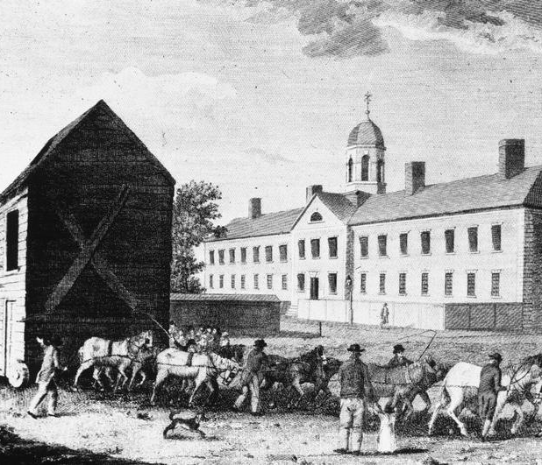
Walnut Street Jail
Solitary was first introduced in 1790 at the Walnut Street Jail in Philadelphia by the Society for Alleviating the Miseries of Public Prisons.
It was seen as a humane alternative to overcrowded jails, whippings, and public humiliation.

Slide 4
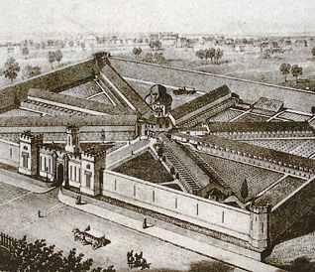
Eastern State Penitentiary
ESP opened in 1829 as an all-solitary prison.
Men were kept alone in their cells to contemplate their sins, seek forgiveness from God, and become “penitent.”
.

Slide 5
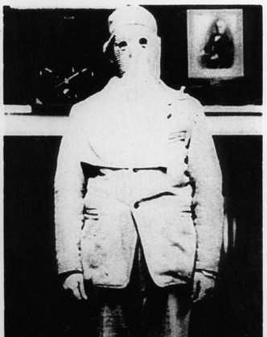
Total Isolation
Prisoners were permitted no possessions, only a Bible.
When escorted outside their cells they wore hoods over their heads.
This was the first system designed to reform, instead of solely to punish.

Slide 6
Alexis de Tocqueville on Solitary Confinement (1830)
“The unfortunates, on whom this experiment was made, fell into a state of depression;…their lives seemed in danger, if they remained longer in this situation; five of them, had already succumbed during a single year; their moral state was not less alarming; one of them had become insane; another, in a fit of despair, had [attempted suicide]. “
“This trial…was fatal to the greater part of the convicts:…this absolute solitude, if nothing interrupts it, is beyond the strength of man; it destroys the criminal without intermission and without pity; it does not reform, it kills.”

Slide 7
Charles Dickens on Solitary Confinement (1842)
“I believe that very few men are capable of estimating the immense amount of torture and agony which this dreadful punishment, prolonged for years, inflicts upon the sufferers…
“I hold this slow and daily tampering with the mysteries of the brain to be immeasurably worse than any torture of the body; and…I denounce it, as a secret punishment which slumbering humanity is not roused up to stay. “

Slide 8
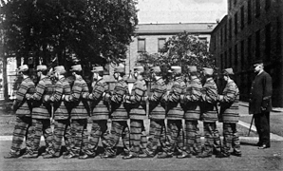
The Auburn System
Prisons began to abandon solitary in favor of the “Auburn System”: daily hard labor in groups, where prisoners worked silently and march in lockstep.
By the late 19th century, long-term solitary was rare.

Slide 9
In re Medley: The United States Supreme Court Denounces Solitary Confinement (1890)
Surveying the use of long-term solitary, the Court found that “a considerable number of the prisoners fell, after even a short confinement, into a semi-fatuous condition, from which it was next to impossible to arouse them, and others became violently insane; others still, committed suicide; while those who stood the ordeal better were not generally reformed, and in most cases did not recover sufficient mental activity to be of any subsequent service to the community.”

Slide 10
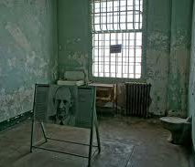
Alcatraz
“The Rock” opened in 1934 to house the “worst of the worst” of the federal prison system.
“The Hole” at Alcatraz was notorious, but most prisoners were not in solitary confinement.

Slide 11
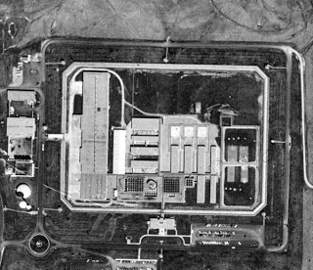
The Marion Lockdown
Opened in the 1960s to replace Alcatraz, Marion went into lockdown in October 1983 after the murders of two guards--and remained that way.
States began to imitate the permanent lockdown model.

Slide 12
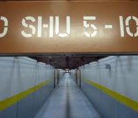
Pelican Bay
Opened in 1989, Pelican Bay was among the first to be purpose-built as a supermax.
It houses more than 1,200 prisoners in solitary confinement, in windowless concrete cells.

Slide 13
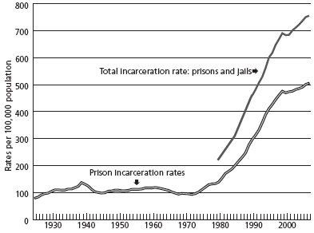
The “War on Crime” and the Culture of Punishment Spurs the Growth of Solitary

Slide 14
Dr. Terry Kupers: How to Create
Madness in Prisons (Part 1)
“Begin by over-crowding the prisons with unprecedented numbers of drug-users and petty offenders, and make sentences longer across the board.
“Dismantle many of the rehabilitation and education programs so prisoners are relatively idle.
“Add to the mix a large number of prisoners suffering from serious mental illness.
“Obstruct and restrict visiting, thus cutting prisoners off even more from the outside world.
“Respond to the enlarging violence and psychosis by segregating a growing proportion of prisoners in isolative settings such as supermaximum security units”....

Slide 15
Dr. Terry Kupers: How to Create
Madness in Prisons (Part 2)
“Ignore the many traumas in the pre-incarceration histories of prisoners as well as traumas such as prison rape that take place inside the prisons.
“Discount many cases of mental disorder as ‘malingering.’
“Label out-of-control prisoners ‘psychopaths.’
“Deny the ‘malingerers’ and ‘psychopaths’ mental health treatment and leave them warehoused in cells within supermaximum security units.
“Watch the recidivism rate rise and proclaim the rise a reflection of a new breed of incorrigible criminals and ‘superpredators.’”

Slide 16
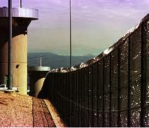
Supermax Boom
Rapid growth took place in the 1990s and early 2000s.
44 states and the federal system now have stand-alone supermax prisons.
Hundreds of other prisons and jails have solitary confinement units.

Slide 17
A Nation in Lockdown
Solitary Confinement in the United States Today

Slide 18
Solitary by the Numbers
2005 census by the Bureau of Justice Statistics: 81,622 individuals held in “restricted housing” in the nation’s prisons.
2005 study: 25,000 of these segregated prisoners held in supermax prisons around the country.
Figures do not include local jails, immigrant detention centers, juvenile facilities or military facilities.
True total is likely to be over 100,000.

Slide 19
Euphemisms for Torture
Administrative Maximum
Special Housing Unit
Security Housing Unit
Restricted Housing Unit
Intensive Management Unit
Behavioral Management Unit
Communications Management Unit
Disciplinary or Punitive Segregation: Punishment for violating prison rules
Administrative Segregation: Based on gang affiliation, political beliefs, original crime, or other classifications
Involuntary Protective Custody: “Protection” for vulnerable people in prison

Slide 20
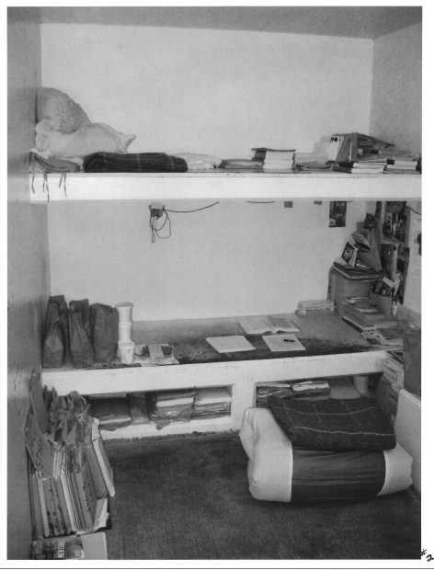
The World in a Cell
Most cells measure less than 8 x 10 feet—the size of a parking space.
Work, education, and rehabilitative programming are banned.
TVs, radios, and reading materials may or may not be permitted.

Slide 21
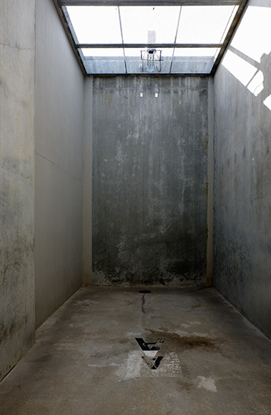
Lockdown 23/7
Prisoners spend 22 to 24 hours alone in cells.
They exercise alone in a walled or fenced enclosure resembling a dog run.
Visits with family are forbidden or severely limited.

Slide 22
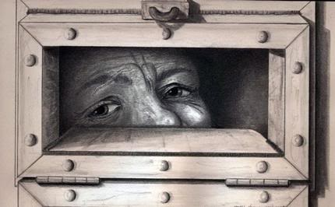
No Way Out
Many cells have no windows.
Some cell doors have bars, but most are solid steel.
“Food slots” are also used for communication with guards, medical treatment, and psychotherapy.
Drawing by Martin Vargas.

Slide 23
Months, Years, and Decades Alone
In California, the average term in solitary is 6.8 years. Of the 1,111 prisoners in the SHU, 513 had served 10 years or more; 78 of these had been in the SHU at least 20 years.
The longest isolated federal prisoner, Thomas Silverstein, has spent 29 years under a “no human contact” order.
The longest isolated state prisoners, Herman Wallace and Albert Woodfox, have are now spending their 40th year in solitary.

Slide 24
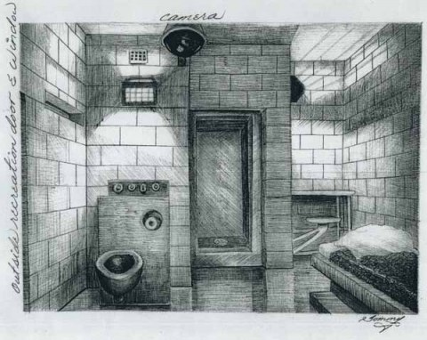
Art from Solitary: Thomas Silverstein,
ADX Florence, CO (29 years)

Slide 25
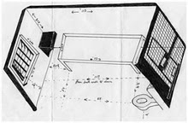
Art from Solitary: Herman Wallace,
Louisiana State Penitentiary at Angola (40 years)

Slide 26
Voices from Solitary: Herman Wallace,
Louisiana State Penitentiary at Angola (40 years)
It’s so small I can only make about four steps forward before I touch the door. And if I turn and I’m about-face at any place in this cell I’m going to bump into something. It’s really smaller than anybody’s bathroom…But I’m used to it and that’s one of the bad things about it…
I’m in the cell for 23 hours a day and a lot of time 24 hours because I don’t come out. I have to spend a great deal of my time catching up on reading and writing to…people that I communicate with. It helps me to maintain what little sanity that I have left, to maintain my humanity and dignity.

Slide 27
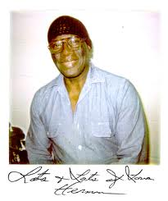
Voices from Solitary: Herman Wallace,
Louisiana State Penitentiary at Angola (40 years)
http://download.guardian.co.uk/audio/kip/standalone/world/1334585861759/5478/gdn.ps.120416.hermanwallace.mp3

Slide 28
American Exceptionalism
The United States is the only democratic nation to practice solitary confinement on a large scale.
Sarah Shourd, the American hiker who spent 13 months in solitary in an Iranian prison, said after her release: “The really scary thing is that the US government and many governments were very critical of Iran for holding me in solitary for 13 and a half months, but when I got out I was shocked to find that the US had more people in solitary confinement than any other country—and in this country it is used routinely as an administrative practice.”

Slide 29
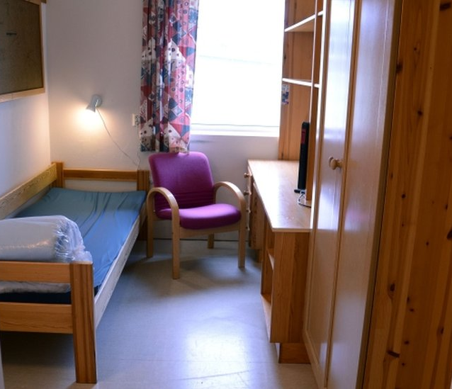
Solitary in Europe
In the UK, solitary is largely banned beyond 3 weeks. Fewer than 40 people are in long-term segregation.
In Norway, mass killer Anders Breivik’s cell has 3 adjoining rooms, including a study and a fitness room with treadmill.

Slide 30
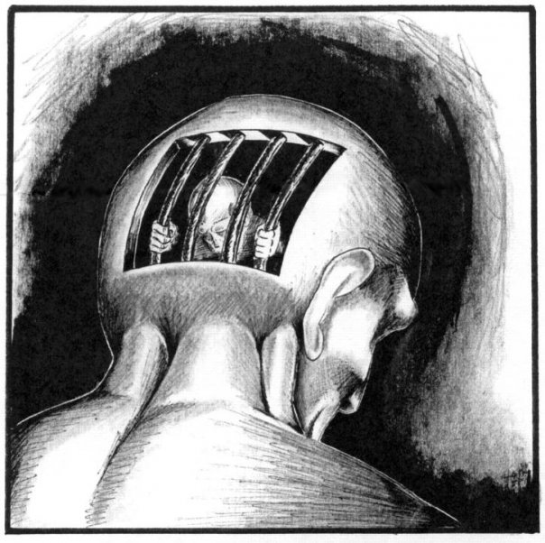
The Psychological Effects of Solitary Confinement
Research since the 1970s shows that that solitary confinement alters neural and therefore psychological states.
Prisoners in solitary develop psychopathologies at much higher rates than those in the general population.
Prisoners exhibited decreased EEG activity after just one week in solitary.

Slide 31
Dr. Stuart Grassian:
Symptoms of “SHU Syndrome”
social withdrawal
panic attacks
irrational rage
loss of impulse control
paranoia
hypersensitivity to external stimuli
severe and chronic depression
difficulties with concentration and memory
perceptual distortions and illusions

Slide 32
Voices from Solitary: Brian Nelson,
Tamms Supermax, IL (12 years)
I lost the will to live. I lost hope, even though I was scheduled to be released in a couple years. Depression overwhelmed me…I lost so much weight…that all the bones in my body protruded…I had no appetite and wanted to die.
“Every day I went to sleep I got down on my knees and prayed that I would die in my sleep, yet God’s will was not mine. When I woke up in the night I prayed harder for death. I couldn’t sleep…I went days pacing back and forth like a zombie… I looked like I was already dead and I had no will to live. Day after day all I saw was gray walls and over time my world became the gray box.”

Slide 33
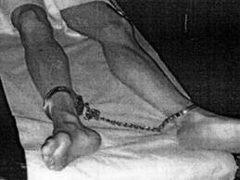
Suicide
In New York, suicides are 5 times higher in solitary.
In California, about 5 percent of all prisoners are in solitary—but up to 70 percent of suicides take place there.
Teens are 19 times more likely to commit suicide when placed in isolation.

Slide 34
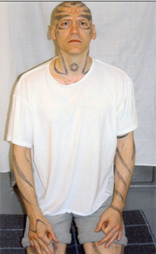
Self-Mutilation
Self-mutilation in the form of cutting, otherwise unknown among adult men, is common practice in solitary confinement.
Prisoners in solitary have been known to bite into their own veins and cut off their fingers and testicles.

Slide 35
Voices from Solitary: Anthony Graves,
Polunsky Unit (Death Row), TX (18 years)
“I would watch guys come to prison totally sane and in three years they don’t live in the real world anymore. I know a guy who would sit in the middle of the floor, wrap [his sheet] around himself and light it on fire. Another guy would go out in the recreation yard, get naked, lie down, and urinate all over himself. He would take his feces and smear it all over his face as though he was in military combat. This same man…was ruled competent to be executed.
“Solitary confinement does one thing; it breaks a man’s will to live and he ends up deteriorating. He’s never the same person again…It’s inhumane by design and it is driving men insane.”

Slide 36

Voices from Solitary: Anthony Graves,
Polunsky Unit (Death Row), TX (18 years)
http://youtu.be/fX0KkqWAwWc?t=2m48s

Slide 37
Common Reasons for Placement in
Solitary Confinement
California
Gang “validation” based on tattoos or reading materials
Possession of five dollars or more without authorization
Participation in a strike or work stoppage
Self mutilation or attempted suicide for the purpose of manipulation
New York
Failure to obey an order promptly
Testing positive for marijuana
“Reckless eyeballing”
Refusing to return a food tray
Possession of an excess quantity of postage stamps

Slide 38
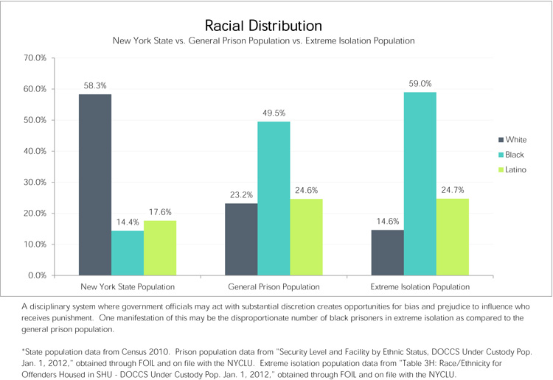
Racial Disparities in the Use of Solitary

Slide 39
Groups Vulnerable to Placement in Solitary Confinement
Prisoners with mental illness or developmental disabilities
Children who misbehave or who are deemed to be in need of “protection”
LGBT individuals
Non-English-speaking prisoners
Muslims, including but not limited to those accused or convicted of terrorism-related offenses
Prisoners who hold “radical” political beliefs or seek to challenge prison conditions
Anyone who complains of abuse by prison officials

Slide 40
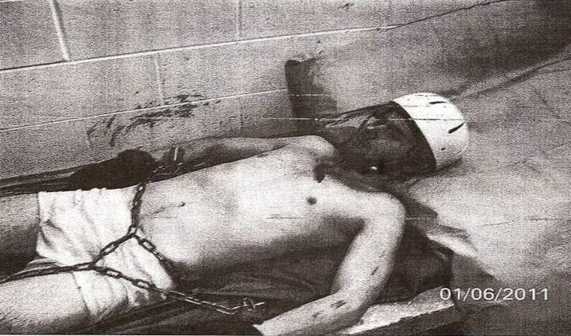
Isolating the Mentally Ill
Up to 1/3 third of prisoners in solitary in state prisons suffer from underlying mental illness.
Most will decompensate further as a result of being placed in isolation.

Slide 41
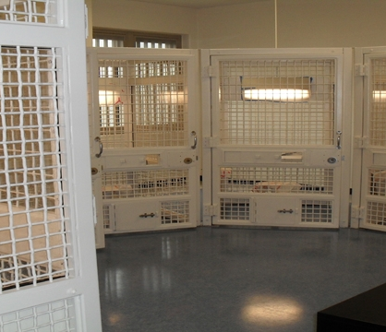
Psychiatric “Treatment”
Treatment, if any, often consists of “therapy” conducted through a feeding slot, or “group therapy” sessions in adjoining cages.

Slide 42
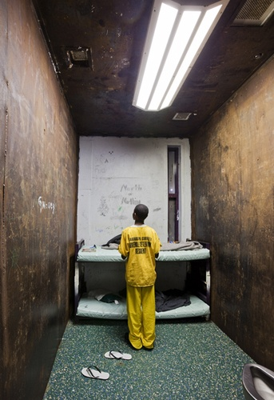
Children in Solitary
Thousands of kids under the age of 18 are held in solitary confinement in adult prisons and jails, for “their own protection” or as punishment.
Hundreds more are held in isolation in juvenile facilities.

Slide 43
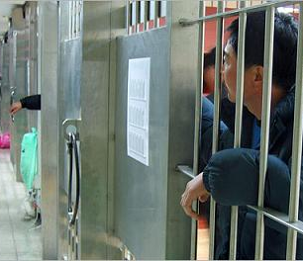
Immigrants in Solitary
Many of the 400,000 people in the immigration detention system each year spend time in solitary, with no due process and no recourse.
Some are asylum-seekers who have been tortured in their countries of origin.

Slide 44
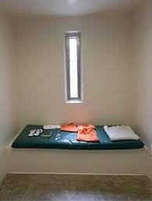
Solitary at Guantánamo
Up to 80 percent of the detainees at Guantánamo Bay have been held in solitary confinement.
They are held in “indefinite detention,” meaning there is no end in sight to their torture.

Slide 45
Voices from Solitary: Adnan Farhan Abdul Latif, Guantánamo Bay, Cuba (11 years)
“I am moving towards a dark cave and a dark life in the shadow of a dark prison. This is a prison that does not know humanity, and does not know [anything] except the language of power, oppression and humiliation for whoever enters it…
“[I will] leave this life which is no longer anymore called a life, instead it itself has become death and renewable torture. Ending it is a mercy and happiness for this soul.”
(Adnan Latif committed suicide in his cell in September 2012.)

Slide 46
The High Cost of Solitary Confinement
In addition to its human costs, solitary confinement is expensive, in large part because of added staffing costs.
One study estimated that the average per-cell cost of housing an inmate in a supermax prison is $75,000, as opposed to $25,000 for an inmate in the general population.
It costs $92,000 per year to hold a prisoner in solitary at Illinois’s Tamms Correctional Center--two to three times more than at the state’s other maximum-security prisons.
The Solitary confinement of some 12,000 state prisoners costs California taxpayers an additional $175 million per year.

Slide 47
Unlocking the Box
The Rising Movement Against Solitary Confinement

Slide 48
National Organizations with Campaigns
Against Solitary Confinement
Amnesty International
American Civil Liberties Union
American Friends Service Committee
Center for Constitutional Rights
Human Rights Watch
National Immigrant Justice Center
National Religious Campaign Against Torture
Physicians for Human Rights

Slide 49
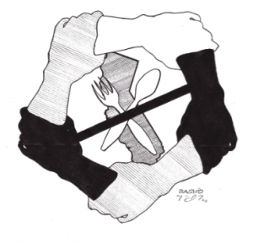
Prisoner Hunger Strikes Against
Solitary Confinement
In 2011-2012:
California
Georgia
Ohio
North Carolina
Virginia

Slide 50
International Agreements Limiting Solitary Confinement
International Covenant on Civil and Political Rights (ICCPR)
UN Convention Against Torture and other Cruel, Inhuman or Degrading Treatment or Punishment (CAT)
UN Standard Minimum Rules for the Treatment of Prisoners (SMR)

Slide 51

UN Special Rapporteur on Torture Juan Mendez Condemns Solitary Confinement
Mendez reports to the UN Commission on Human Rights
In October 2011, he called for a total ban on solitary for juveniles, mentally ill, pre-trial detainees.
Solitary should be limited to 15 days for everyone else, and used only for safety purposes.

Slide 52
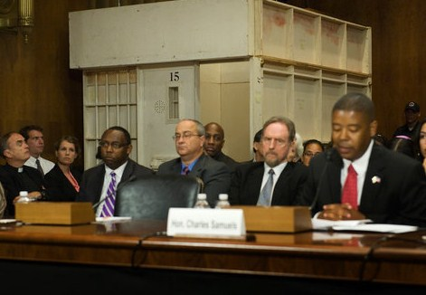
Senate Judiciary Subcommittee Hearing on Solitary Confinement
June 19, 2012: “Reassessing Solitary Confinement: The Human Rights, Fiscal and Public Safety Consequences”
First Congressional hearing held on solitary, with testimony from corrections officials, legal experts, psychiatrists, survivors

Slide 53
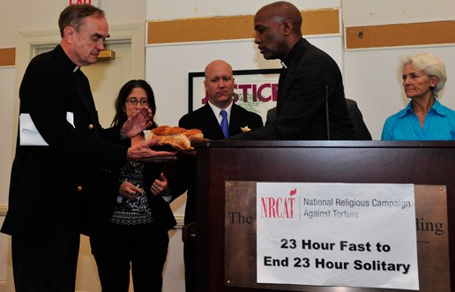
23-Hour Fast to End 23-Hour Solitary
National Religious Campaign Against Torture sponsors a one-day fast in run-up to Senate hearing.
Participants include people of faith from around the country.

Slide 54
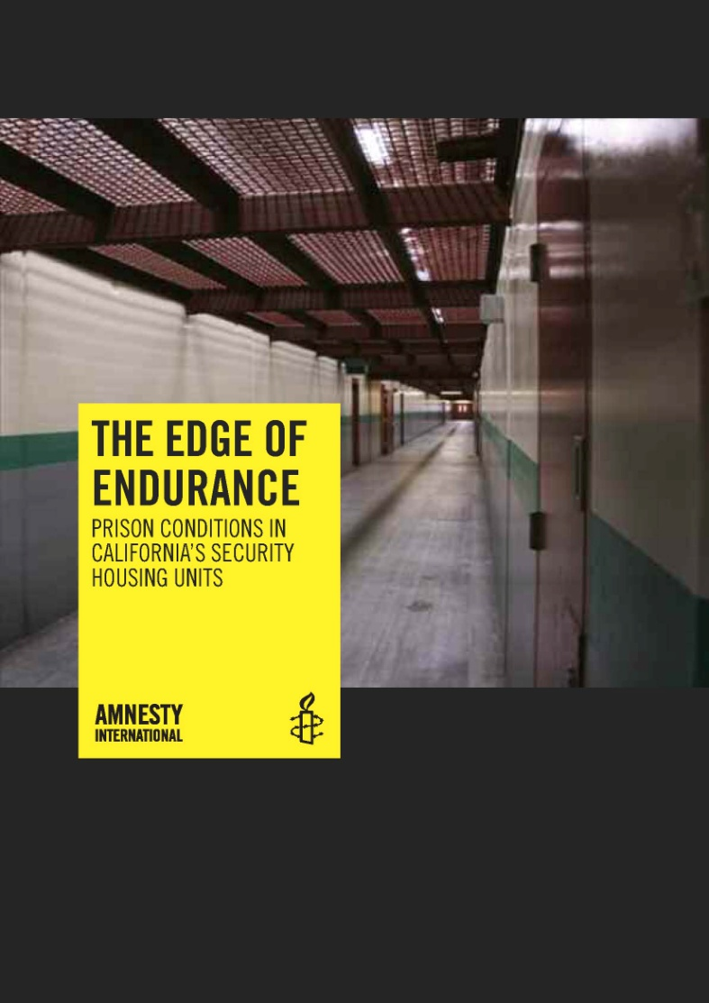
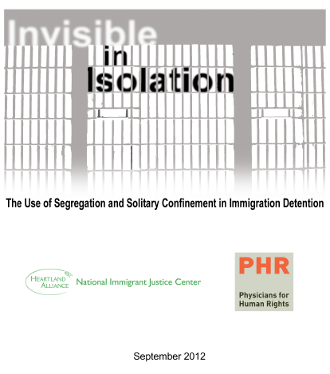
Documenting Solitary Confinement (1)

Slide 55

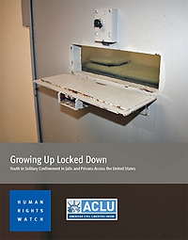
Documenting Solitary Confinement (2)

Slide 56
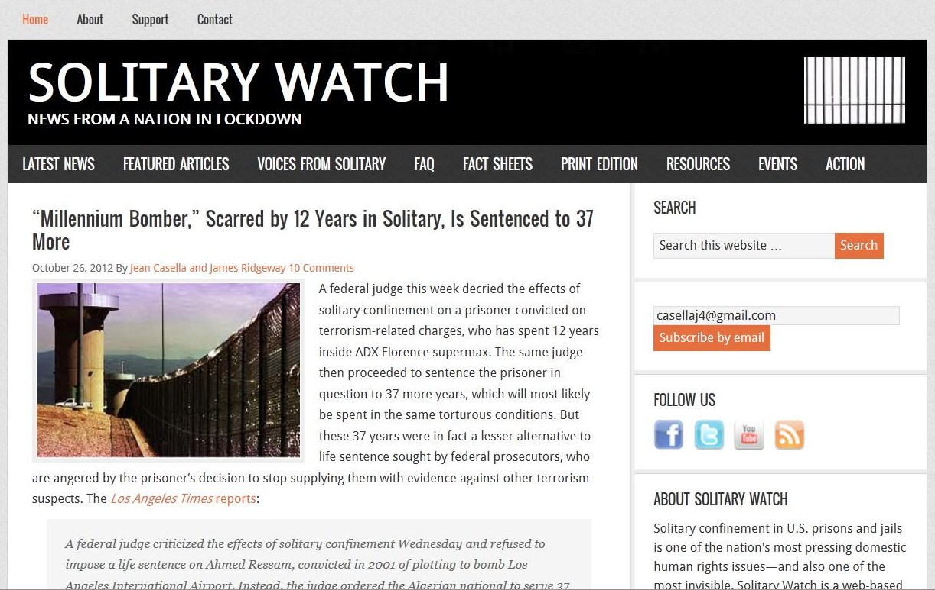
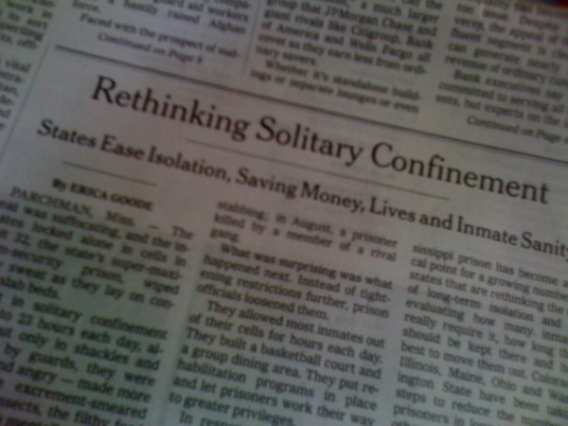
Media Coverage of Solitary Confinement
Alternative media
Mainstream media

Slide 57
Models for Change
Mississippi
Years of litigation by the ACLU
Joint involvement of DOC, ACLU, psychiatrists, health care providers and prison experts in “reclassification” of prisoners in solitary
Result: 75 percent reduction in solitary confinement
Maine
Grassroots activism
Press exposé
Legislation introduced and study commissioned
New leadership at the DOC
Result: 50 percent reduction in solitary confinement

Slide 58
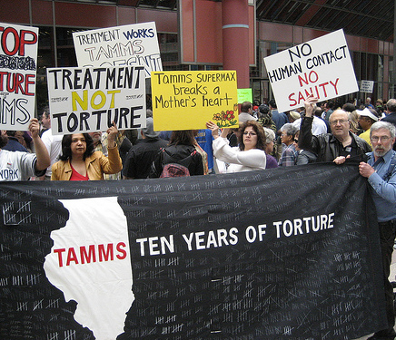
Activism in Illinois
Grassroots activism by Tamms Year Ten
Litigation by Uptown People’s Law Center
Press exposé
Concern over high cost
Action by governor

Slide 59
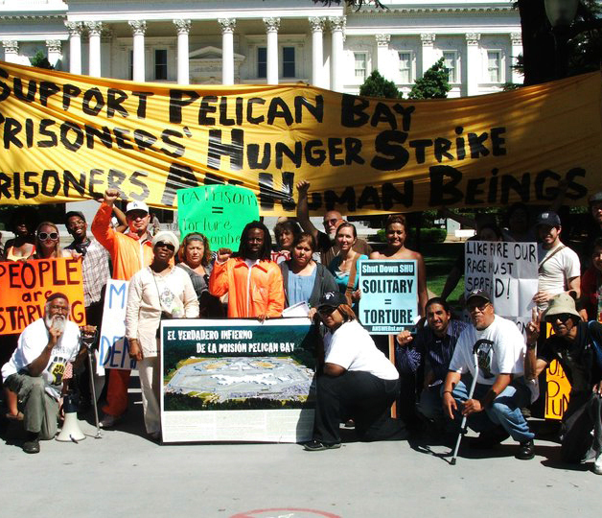
Activism in California
Hunger strike by group in solitary spreads through prison system
Grassroots activism
Amnesty International Report
Widespread press coverage

Slide 60
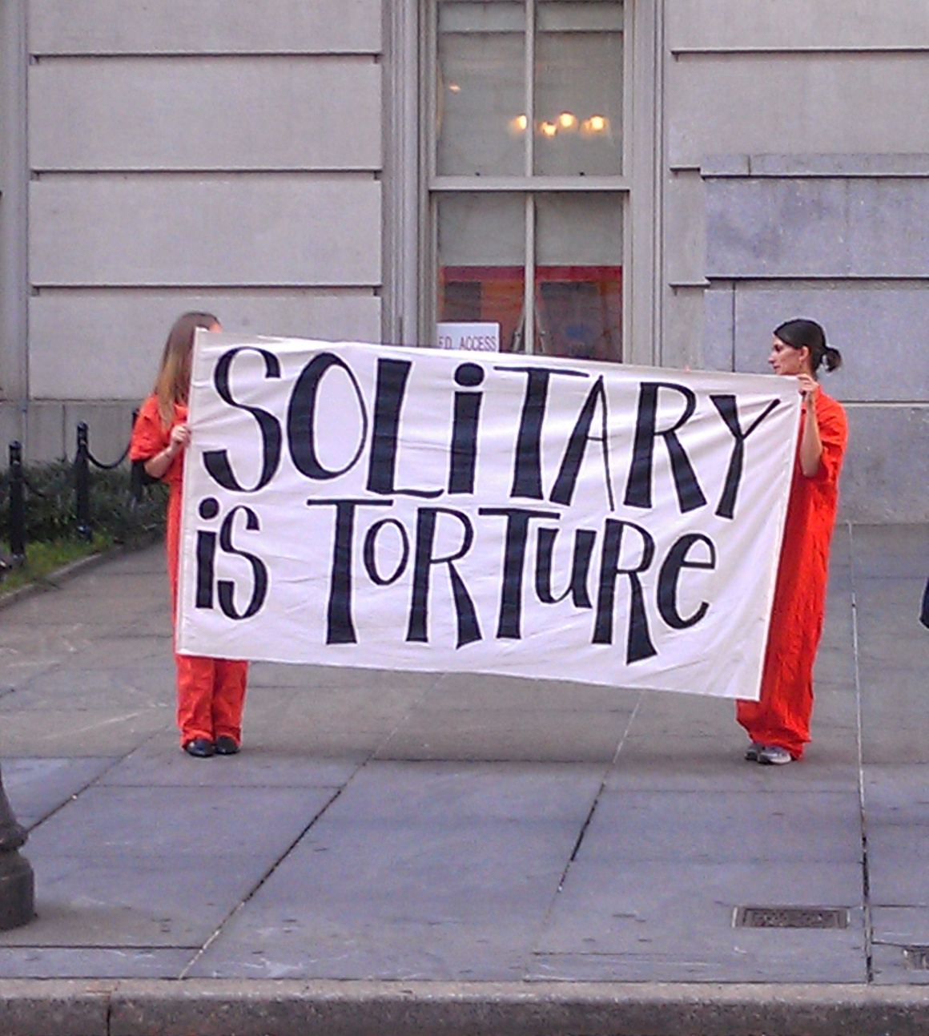
Activism in New York
Litigation and legislation to limit solitary for people with mental illness
Grassroots activism on state and city levels
NYCLU report
Press coverage
Meetings with legislators

Slide 61
Activism in Other States
Arizona
Colorado
Louisiana
Maine
Maryland
New Jersey
New Mexico
Ohio
Pennsylvania
Texas
Virginia

Slide 62
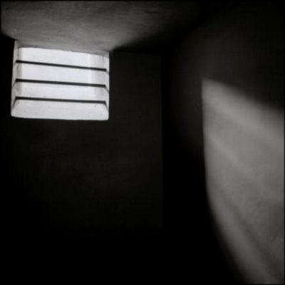
To Be Continued…

Slide 63
© 2012 by Solitary Watch
www.solitarywatch.com
This presentation may be used, shared, or adapted only under the terms of the Creative Commons Attribution-Non-Commercial License: http://creativecommons.org/licenses/by-nc/3.0/
Created by Jean Casella
Research by Katie Rose Quandt and Sal Rodriguez
Contact: solitarywatchnews@gmail.com
PO Box 11374, Washington, DC 20008

